Slide 1
JavaScript Events
Javascript has events to provide a dynamic interface to a webpage.
These events are hooked to elements in the Document Object model(DOM).
In the case of the Web, events are fired inside the browser window, and tend to be attached to a specific item that resides in it — this might be a single element, set of elements, the HTML document loaded in the current tab, or the entire browser window.
We can bind events either as inline or in an external script.

Slide 2
Basic Concepts of EVENT hANDLING
Non Event Driven Programming or Conventional Programming – Programs are executed by the user input data or according to the code.
Event Driven Programming – Programs are executed by User Interaction .
Event – Notification that something specific occurred, Eg – completion of loading of a document, Browser User action, Mouse click on a form button. It is an Object created by the browser and the javaScript inresponse to something that happened.
Event Handler – Each available event has an event handler, a script, which is a block of code (usually a user-defined JavaScript function) that will be run when the event fires. When such a block of code is defined to be run in response to an event firing, we say we are registering an event handler. Note that event handlers are sometimes called event listeners. Eg. Check for errors or omissions in user input .Similar to exception Handling in C++ or java.
Registration – Process of connecting an Event Handler to an Event.
1. Assigning tag attributes.
2. Assigning Handler addresses to Object Properties

Slide 3
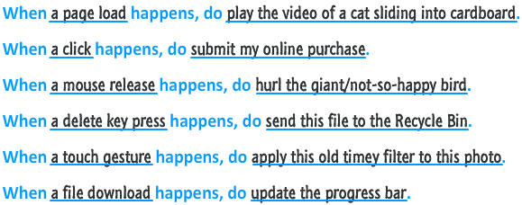
EXAMPLES OF EVENTS

Slide 4
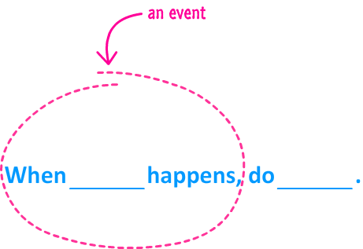
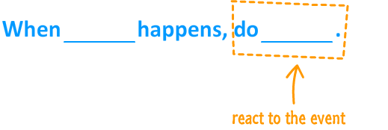

Slide 5
Javascript Events
To work with events, there are two things you need to do:
Listen for events
inline model
traditional model
W3C model
React to events

Slide 6
Inline Model
<body>(
<input type="button" id="askme" value="Ask me" onclick="ask()"/>
<script>
function ask(){
var a =window.prompt("Please ask a question")
alert("I am sorry I don't know the answer")
}
</script>
</body>

Slide 7
Traditional Model
<body>
<input type="button" id="askme" value="Ask me"/>
<script>
var a=document.getElementById("askme");
a.onclick=ask;
function ask(){
var a =window.prompt("Please ask a question")
alert("I am sorry I don't know the answer")
</script>
</body>

Slide 8
W3C Model
<body>
<input type="button" id="askme" value="Ask me" />
<script>
var a=document.getElementById("askme");
a.addEventListener("click",ask,false)
function ask(){
var a =window.prompt("Please ask a question")
alert("I am sorry I don't know the answer")
}
</script>
</body>

Slide 9
Common Events
Event | Event is fired...
click | ...when you press down and release the primary mouse button / trackpad /
mousemove | ...whenever your mouse cursor moves
mouseover | ...when you move the mouse cursor over an element. This is the event you would use for detecting a hover!
mouseout | ...when your mouse cursor moves outside the boundaries of an element.
dblclick | ...when you quickly click twice.
load | ...when your entire document (DOM, external stuff like images, scripts, etc.) have fully loaded.
keydown | ...when you press down on a key on your keyboard
keyup | ...when you release a key press on your keyboard
scroll | ...when an element is scrolled around

Slide 10
ADDEventListener() and removeEventListener()
Inside the addEventListener() function, we specify two parameters — the name of the event we want to register this handler for, and the code that comprises the handler function we want to run in response to it. Note that it is perfectly appropriate to put all the code inside the addEventListener() function, in an anonymous function.
removeEventListener(), a counterpart function which removes a previously added listener. For larger, more complex programs it can improve efficiency to clean up old unused event handlers.
We can also register multiple handlers for the same listener.
myElement.addEventListener('click', functionA);
myElement.addEventListener('click', functionB);
Handling events from text box and password elements
They create four events blur, focus, change select

Slide 11
Event objects
Sometimes inside an event handler function, you might see a parameter specified with a name such as event, evt, or simply e. This is called the event object, and it is automatically passed to event handlers to provide extra features and information.
The target property of the event object is always a reference to the element that the event has just occurred upon. Eg.e.target
e.target is useful when you want to set the same event handler on multiple elements and do something to all of them when an event occurs on them.

Slide 12
Mouse events
onmouseover event corresponds to hovering the mouse pointer over the element and its children, to which it is bound to.
onmouseout event fires when the mouse cursor leaves the element.
onmousemove event fires whenever the user moves the mouse
onmouseup event listens to left and middle mouse click
onmousedown event listens to left, middle, and right mouse clicks
onclick only handles left click.

Slide 13
event Object & this
event object stores information about the event that called the event-handling function
In an event-handling function, this refers to the DOM object on which the event occurred
this keyword enables one event handler to apply a change to one of many DOM elements, depending on which one received the event

Slide 14
event Object Properties

Slide 15

Preventing default behaviour
To stop an event doing what it does by default we call the preventDefault() function on the event object.
var form = document.querySelector('form');
var fname = document.getElementById('fname');
var lname = document.getElementById('lname');
var submit = document.getElementById('submit');
var para = document.querySelector('p');
form.onsubmit = function(e)
{
if (fname.value === '' || lname.value === '')
{ e.preventDefault(); para.textContent = 'You need to fill in both names!';
}
}

